Slide 1
Introduction to Cloud

Slide 2
Outline
Getting to know the cloud
Cloud and other similar configurations
Components of Cloud Computing
Cloud Types
Private Cloud
Community Cloud
Public Cloud
Hybrid Clouds.

Slide 3






















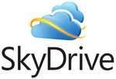


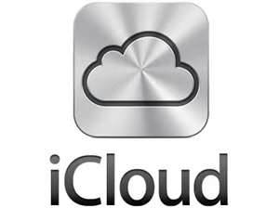









Have you used the cloud?
Notes:
Take the poll
Have you used the cloud
For one, two, three, or more of these services

Slide 4
Getting to know the cloud
Cloud computing is “a model for enabling convenient, on-demand network access to a shared pool of configurable computing resources ( e.g. networks, servers, storage, applications and services) that can be rapidly provisioned and released with minimal management effort or service provider interaction.”
Five silent features of a cloud computing
On-demand self-service
Broad network access
Resource pooling
Rapid elasticity
Measured service

Slide 5

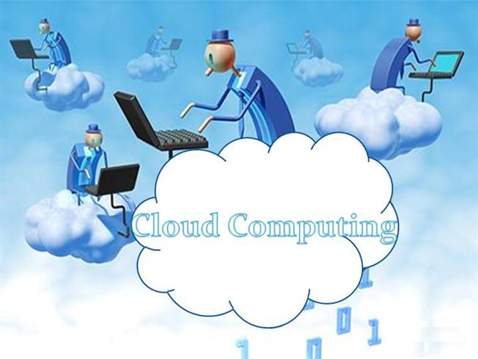

Slide 6
Cloud and other similar configurations
Terms that helps in distinguishing these from cloud computing.
Application Service Provider
Autonomic Computing
Cluster
Distributed Computing
High Performance Computing (HPC)
Utility Computing

Slide 7
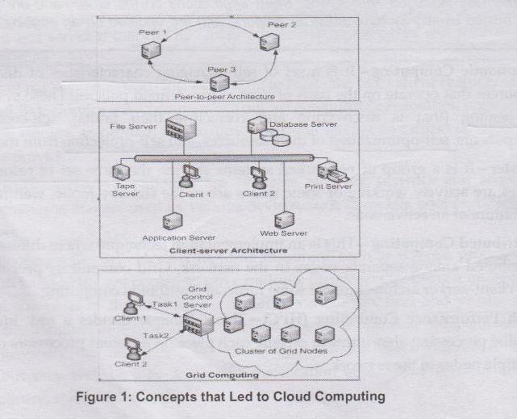
Peer to Peer, Client-Server & Grid Computing

Slide 8
Cloud Computing Vs Peer-to-Peer Architecture.
Cloud Computing Vs Client-Server Architecture.
Cloud Computing Vs Grid Computing.
Cloud Computing Vs Server Virtualization.

Slide 9
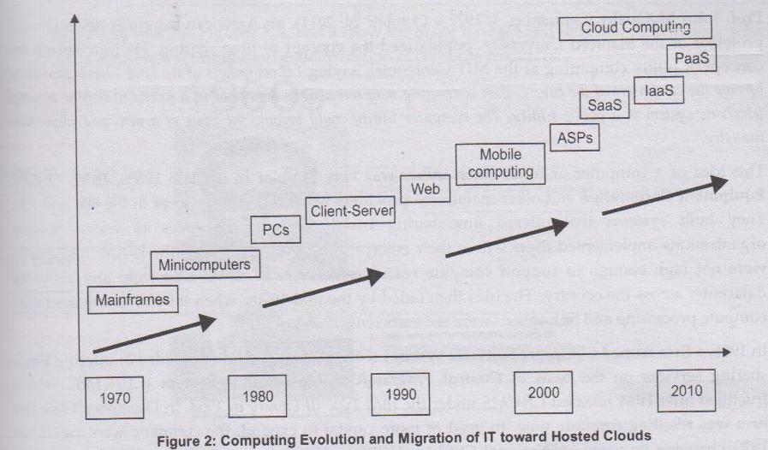
How we Got to the Cloud

Slide 10
Components of Cloud Computing
For the end users, Cloud Computing consists of the following :
1) Client
2) Cloud network
3) Cloud Application Programming Interface (APIs)
1) Client :
Cloud clients are divided into three broad categories
Mobile clients
Thin Clients ( there is little hardware and software installed on the user's machine.
Thick clients

Slide 11
2)Cloud network
Connecting link between the user and cloud services.
Internet is most common choice.
3) Cloud Application Programming Interface (APIs)
Is a set of programming instruction and tool that provides abstractions over a specific provider cloud.
Used to build applications in the cloud computing market.
APIs help programmers to have a common mechanism for connecting to a particular cloud services
Figure illustrate the various aspects of cloud computing

Slide 12
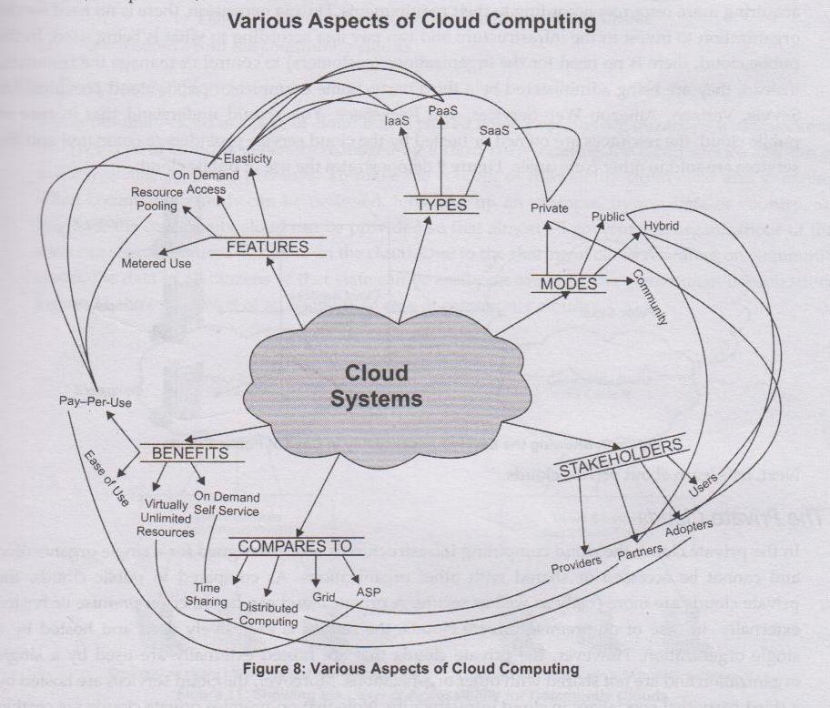

Slide 13
Cloud Types
Public Cloud
Private Cloud
Community Cloud
Hybrid Clouds.

Slide 14
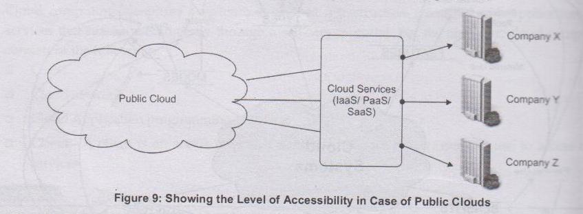
Public Cloud

Slide 15
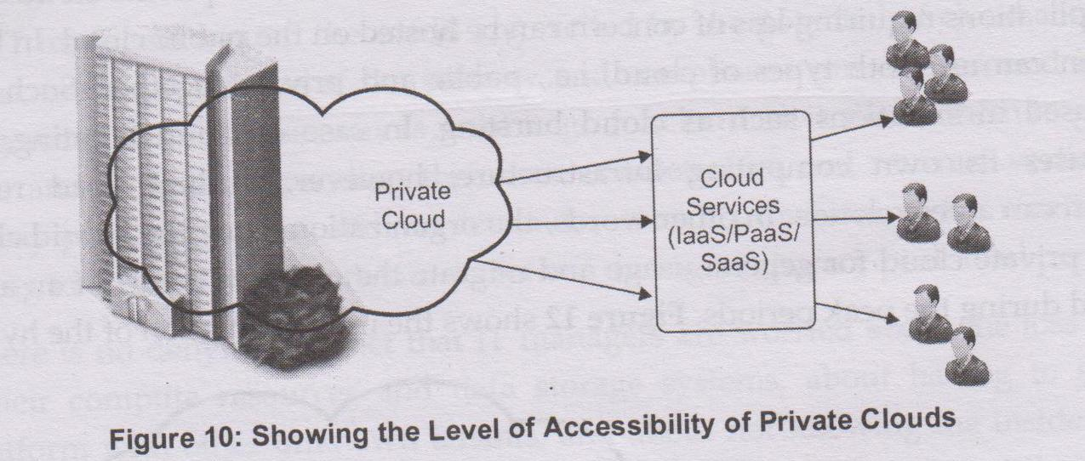
Private Cloud

Slide 16
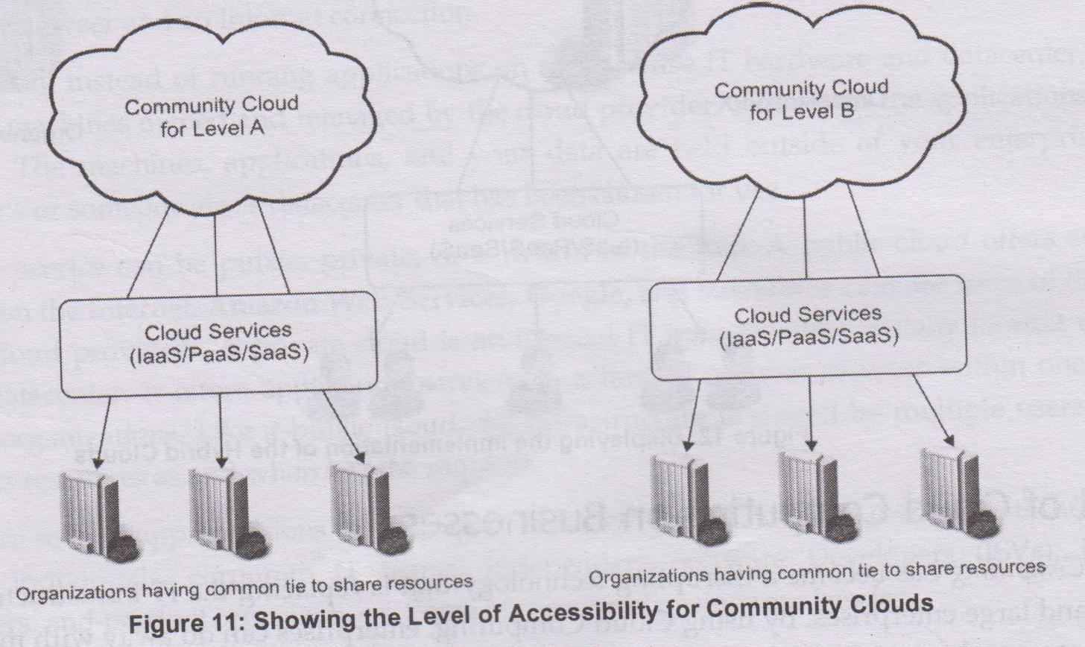
Community Cloud

Slide 17
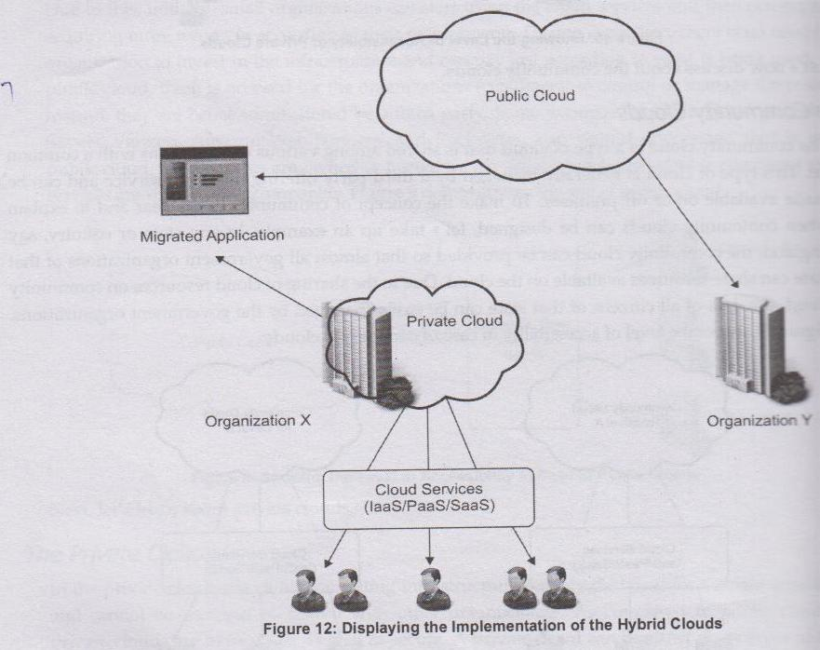
Hybrid Clouds

Slide 18
Impact of cloud computing on Business
The cloud is not for everyone-When you might not benefit from the cloud
Limitations of cloud computing
Data privacy and confidentiality
Loss of control on all user data because of third party
Complexity in tracking operation
Unpredictable available of services
Inability to use services when disconnected from internet
Uneven performance and delay response time to the end users due to WAN-based network access

Slide 19
Cloud computing service delivery models
IaaS
PaaS
SaaS

Slide 20
Thank You!!

